Slide 1
Accident Prevention System
Science model on preventing road accidents
Aakarshi Singh

Slide 2
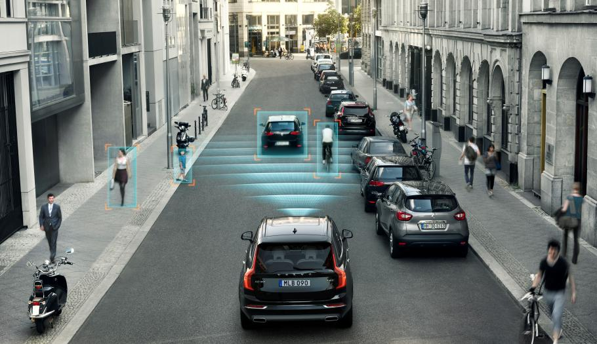
Agenda
Indian Road Network
Vehicle Population in India
Road Accident Statistics in India
Causes of Road Accidents
Conclusion
Safety Features on Road
Safety Features in Vehicle

Slide 3
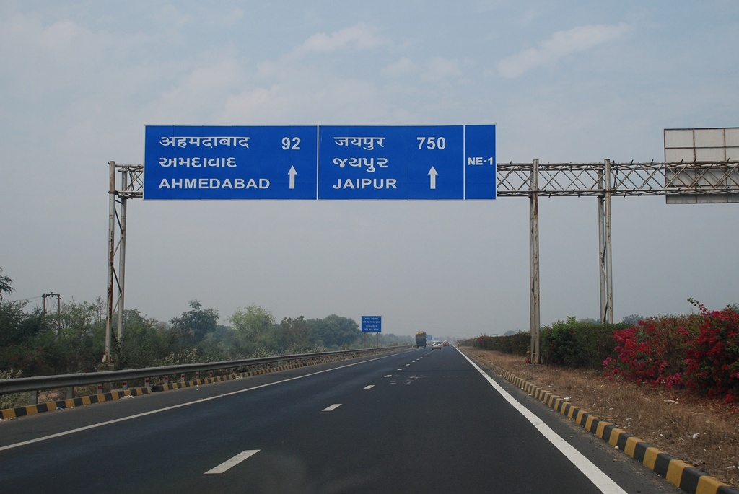
Indian Road Network
India has a road network of over 5,603,293 km as on 31 March 2016
The second largest road network in the world
The length of national highways in India has increased from 70,934 km in 2010-11 to 101,011 km in 2015-16
Source: wiki

Slide 4
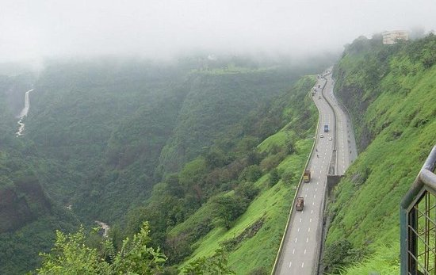
Growth of Road Network by Categories (in km)
Road Category | 2000-01 | 2010-11 | 2015-16
National Highways | 57,737 | 70,934 | 101,011
State Highways | 132,100 | 163,898 | 176,166
District Roads | 736,001 | 998,895 | 561,940
Rural Roads | 1,972,016 | 2,749,804 | 3,935,337
Urban Roads | 252,001 | 411,679 | 509,730
Project Roads | 223,665 | 281,628 | 319,109
Total | 3,373,520 | 4,676,838 | 5,603,293
Source: wiki

Slide 5
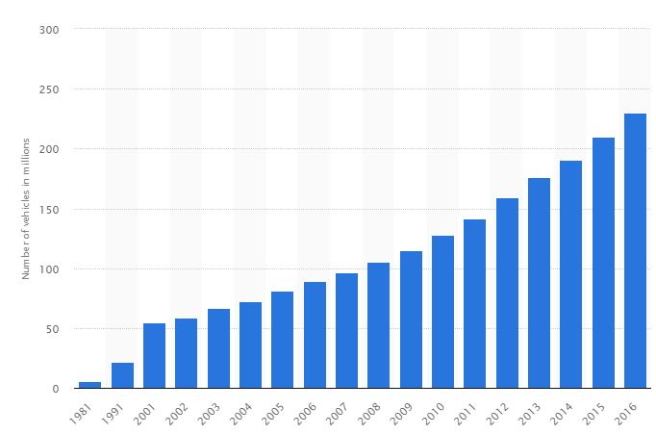
Vehicle Population in India
53,700 vehicles registered across country every day
Annual registration of vehicles was less than 10 lakh till 1993
In 2014, the total registrations stood at 1.94 crore.
Source: TOI
Total number of vehicles across India from 1981 to 2016 (in millions)

Slide 6
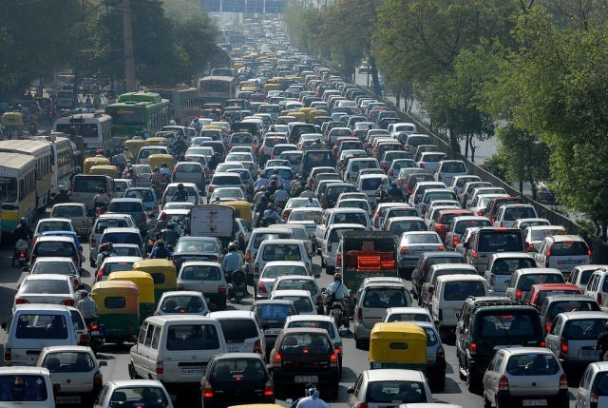
Vehicle Population in Gujarat
The number of vehicles registered annually was below 10 lakh till 2009-2010.
In 2010-2011, annual vehicle registrations crossed 10 lakh.
The number of vehicles registered in Gujarat has increased from 10,289,056 in 2007-08 to 20,361,296 in 2015-16.
Current number of registered vehicles stands at 23,286,418
Source: RTO-Gujarat

Slide 7
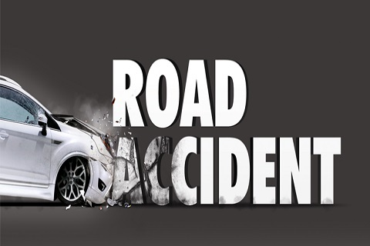
Road Accident Statistics in India (2016)
Total number of road accidents - 4,80,652
Persons killed - 1,50,785
Average – 1,317 accidents and 413 deaths every day
Average – 55 accidents and 17 deaths every hour.
The number of fatal accidents, i.e., accident in which at least one victim dies, has increased consistently since 2005 and seen a sharp rise from 1,31,726 in 2015 to 1,36,071 in 2016.
Source: Ministry of Road Transport

Slide 8
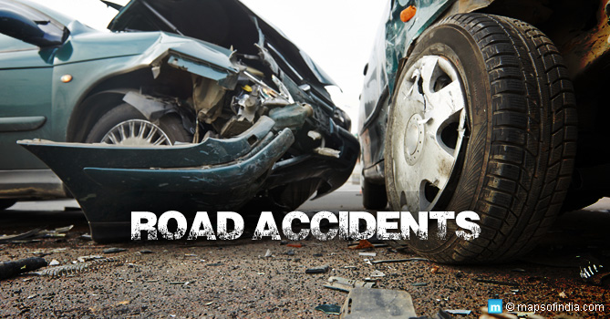
Is there any relation between increasing road length and accidents?
More roads means more place for accident?
Is there any relation between increasing number of vehicles and accidents?
More vehicles means more chances for accident?
Lets see the comparative data of road length vs number of vehicles and number of accidents

Slide 9
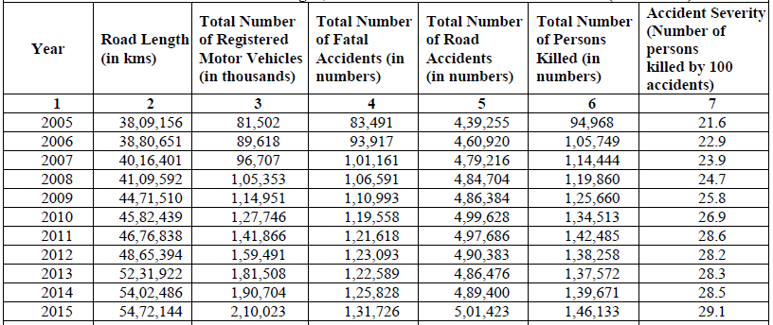
Road Accident Statistics in India Road Length, Motors Vehicles and Road Accidents (2005-2015)
Source: Ministry of Road Transport

Slide 10
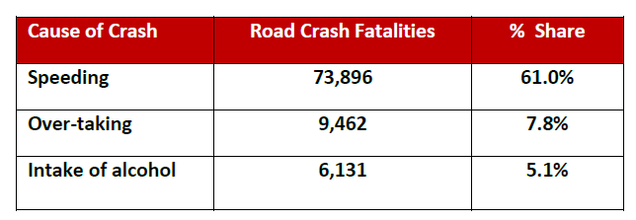
Causes of Road Accidents
Traffic junctions are points of conflict and hence, are prone to road accidents.
About 37 per cent of total accidents took place on junctions itself during the calendar year 2016.
Within traffic junctions, uncontrolled ones contributed to a major portion of road accidents underscoring the importance of traffic control mechanism at junctions.
Source: Ministry of Road Transport
Other factors of road accidents

Slide 11
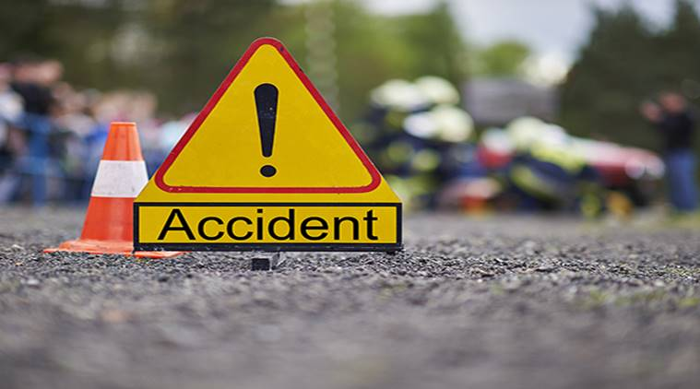
Conclusion
All the data simply shows the need for more safety features on roads and in vehicles.
The accident prevention model demonstrates both
Safety features on road
Safety features in vehicle
Safety features on road
Rumble Strips
Intelligent signal system on crossings and on U-Turn in mountain areas
Safety features in vehicle
Adaptive Cruise Control
Automatic Emergency Braking

Slide 12
Thanks!
Science model on preventing road accidents
Aakarshi Singh

